Slide 1

Tesla Inc.
Team 2: Data Analyst 1
Vanessa Munoz
Roxana Cuevas
Uraja Lad
This Photo by Unknown author is licensed under CC BY-SA.

Slide 2
Table of Contents
Milestone 3: Our Dataset and Business Understanding, Business Objectives, Business Process Model
Milestone 4: Data Understanding (Describe Data, Explore Data, and Verify Data)
Milestone 5: Modeling
Milestone 6: Progress Report

Slide 3
TESLA Business Understanding (Milestone 3)
Elon Musk had stated that Tesla would manufacture 1,500 Model 3 cars in 2017 and increase output to 5,000 vehicles per week (total of 65,000 cars). By the end of 2017, Tesla had surpassed both Ford and GM to claim the title of most valued American electric vehicle manufacturer. In 2016, Elon Musk revealed the second phase of his grand plan for the organization, outlining how it would carry out its mission to quicken sustainable energy development.
With the aim to sell millions of electric vehicles annually by 2030, Tesla, Inc. is a business that seeks to accelerate the global switch to sustainable energy. As Tesla, Inc. develops new technology integrated into its vehicles, all qualified students and new workers should have access to a variety of new jobs. The rise of the global economy will now be supported by Tesla's most recent approach to creating new positions.

Slide 4
Business Objectives
Tesla faces many issues brought by its shortage of batteries. This results in manufacturing delays and the inability to meet increasing demand.
Battery shortage presents an opportunity for Tesla to consider bringing battery production technology in-house.
By analyzing data from the U.S. Department of Education, we will be able to show that there is a pool of qualified candidates across the nation, thus assuring that Tesla could bring battery production to the U.S.

Slide 5
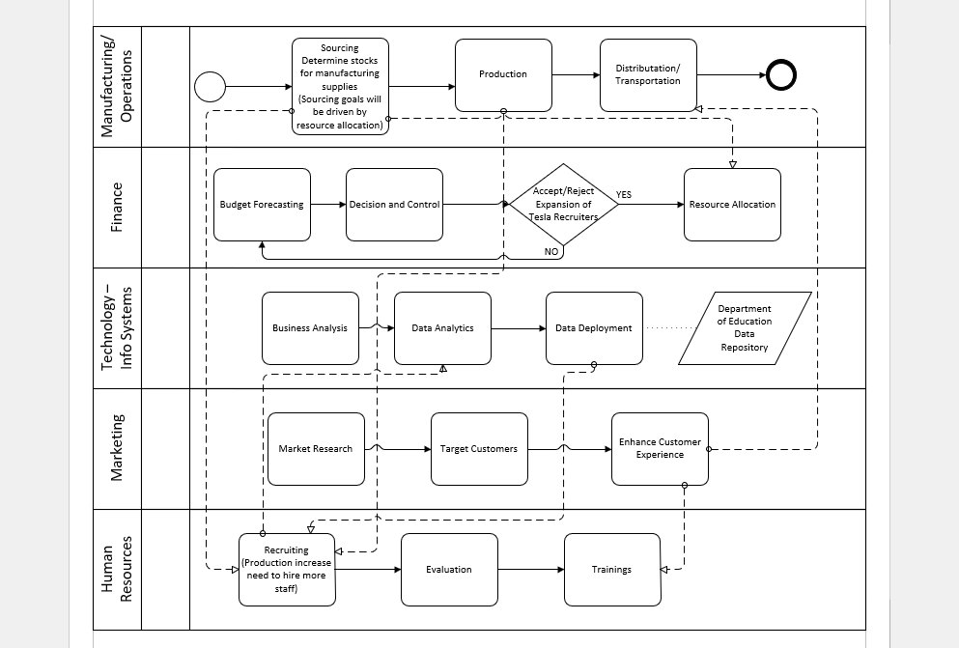
Business Process Model

Slide 6
Data Understanding (Milestone 4)
Institution-level data files for 2018-2021 were acquired from U.S. Department of Education
Of 2990 possible variables 15 were chosen to solve the data analysis goal, and out of those 15 our top 6 variables include:
Enrollment of undergraduate certificate/degree-seeking students
Percentage of degrees awarded in Computer and Information Sciences and Support Services
Percentage of degrees awarded in Social Science fields
Percentage of degrees awarded in Precision Production
Percentage of degrees awarded in Mathematics and Statistics
Percentage of degrees awarded in Mechanic and Repair Technologies/Technicians

Slide 7
Data Understanding: Top Variables
Enrollment of Undergraduate Certificate/Degree-Seeking Students
Percentage of Degrees Awarded in Computer and Information Sciences and Support Services

Slide 8
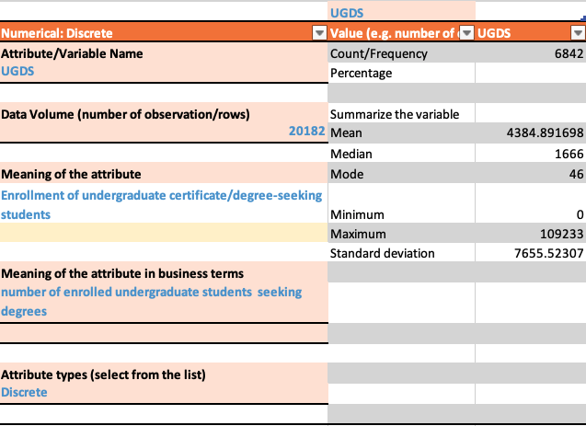
Data Understanding Variable Enrollment of Undergraduate Certificate/Degree-Seeking Students
Key Findings:
Attribute Type Discrete as this number reflects whole numbers of total number of enrollees
Data ranges from 0-109,233 for
Null Value Assessment
Null values will be ignored
Rationale - these represent data for institutions that did not report this information

Slide 9
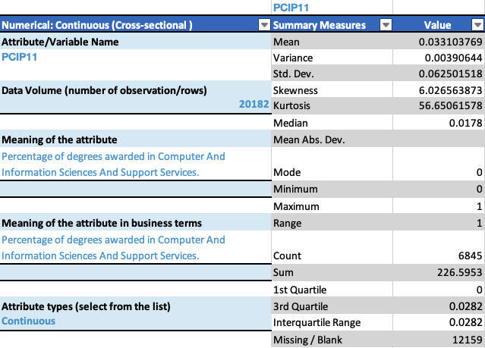
Data Understanding Variable Percentage of Degrees Awarded in Computer and Information Sciences and Support Services
Key Findings:
Attribute Type Continuous as this number reflects decimal percentages of degrees awarded in one field
Null Value Assessment
12,159 missing or 0 values these will be ignored
Rationale - because some percentages represented in decimal format, such as 0.01, are rounded to 0 and should be included in the analysis.
Additionally, 0 may also represent some institutions that do not offer this major as part of their programs

Slide 10
Data Understanding: Top Variables
Percentage of degrees awarded in Social Science fields
Percentage of degrees awarded in Precision Production

Slide 11
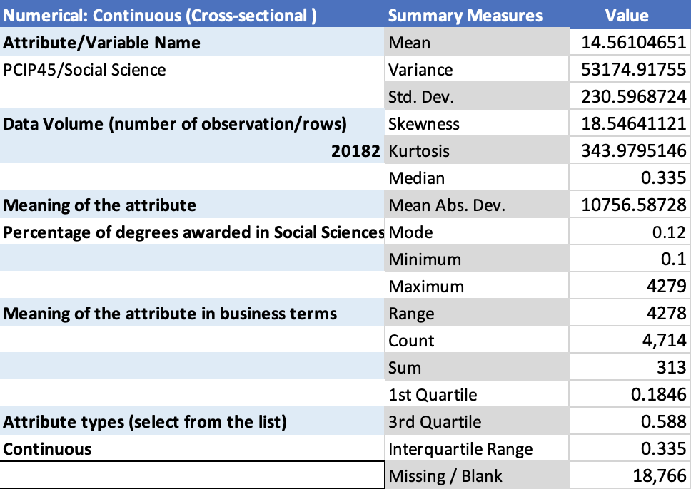
Data Understanding “Percentage of degrees awarded professions of Social Science fields”
Key Findings:
Attribute Type: Continuous
Since this number represents the decimal percentage of degrees granted in a single field.
Missing Blank values totaling more than 18,000 or 0 values will be ignored.

Slide 12
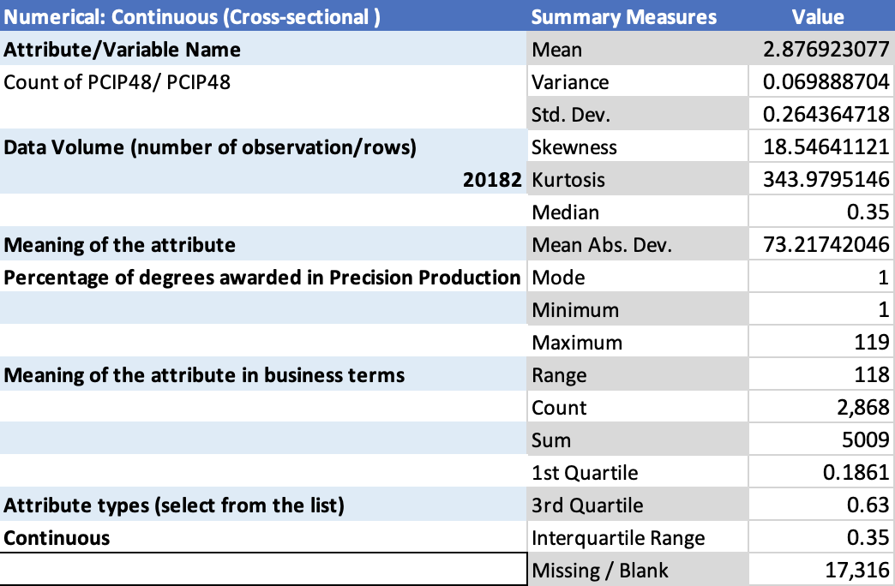
Data Understanding “Percentage of degrees awarded professions of Precision Production”
Key Findings:
Attribute Type: Continuous
Since this number represents the decimal percentage of degrees granted in a single field.
Missing Blank values totaling more than 17,000 or 0 values will be ignored.

Slide 13
Data Understanding: Top Variables
Percentage of degrees awarded in Mathematics and Statistics
Percentage of degrees awarded in Mechanic and Repair Technologies/ Technicians

Slide 14
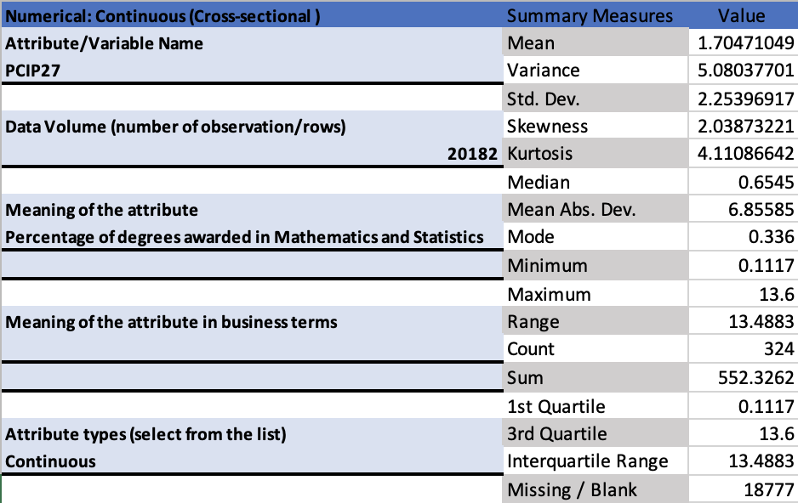
Data Understanding – Variable Percentage of degrees awarded in Mathematics and Statistics
Key Findings:
Attribute type: Continuous as the variable represent percentage of degrees awarded.
Overall, the null and zero values will be avoided.

Slide 15
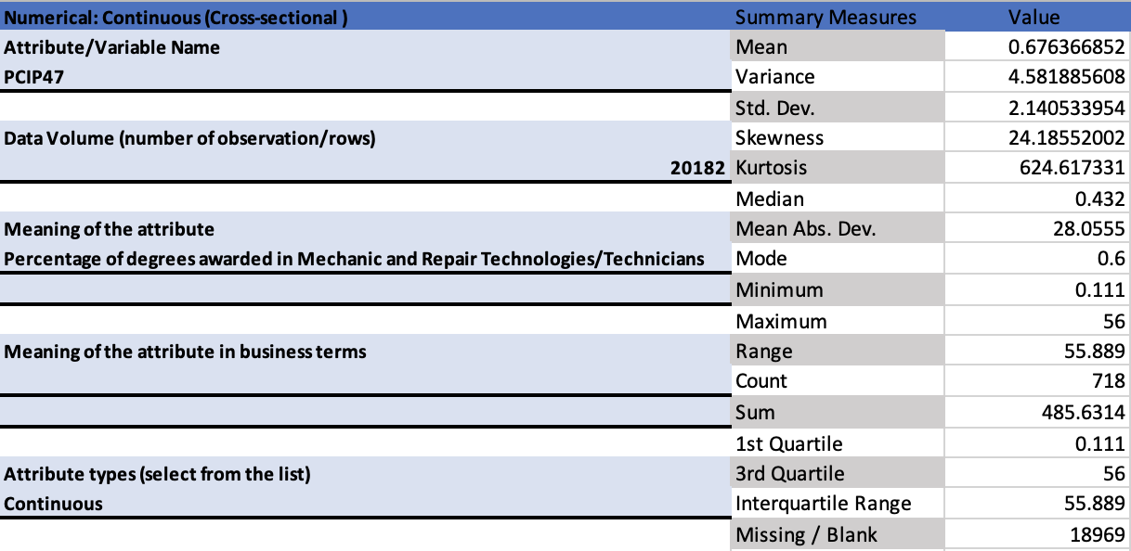
Data Understanding – Variable Percentage of degrees awarded in Mechanics and Repair Technology/Technicians
Key Findings:
Attribute type: Continuous as the variable represent percentage of degrees awarded.
The null values will be avoided because there is about 12% compared to the total value of the variable.

Slide 16
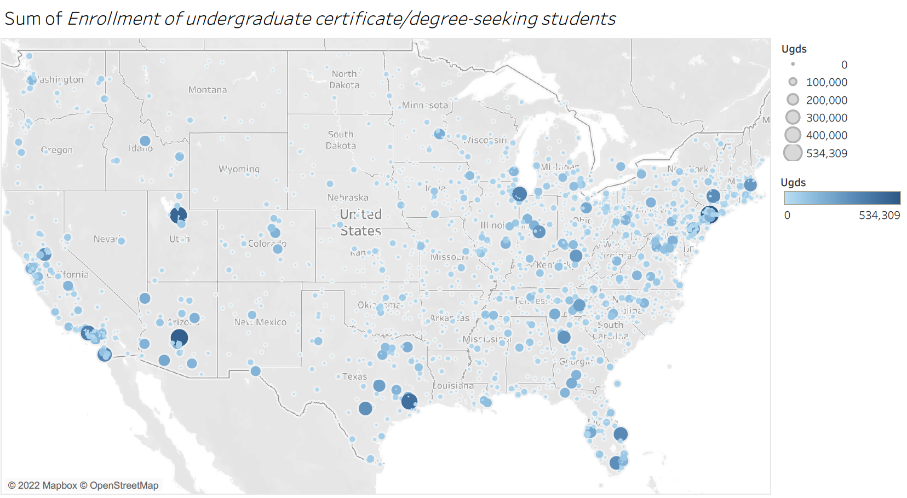
Enrollment of Undergraduate Certificate/Degree-Seeking Students
Data Modeling
Key Findings:
The East Coast has the highest concentration of overall enrollments during 2018-2021.
· States such as California, Texas, New York, Pennsylvania, Florida have the highest number of enrolled students for certificates and degrees between 2018-2021.
· This data shows that Tesla has several options in areas where a battery manufacturing factory could be opened and adequately staffed with sufficient qualified candidates.

Slide 17
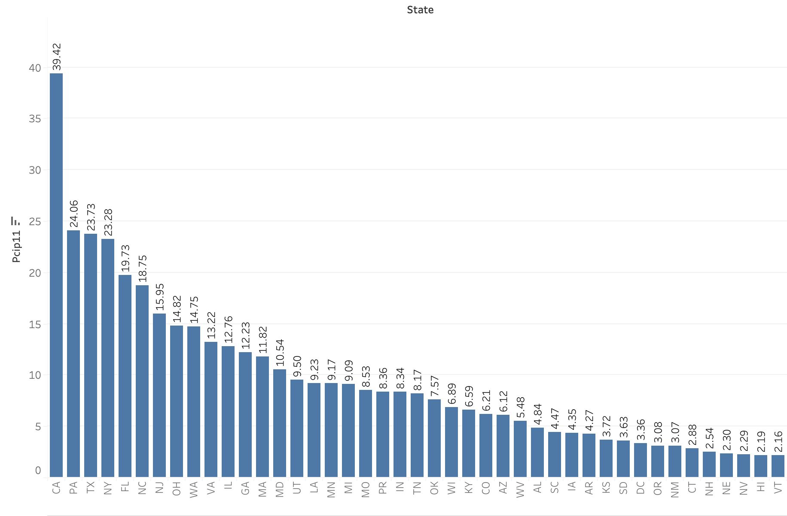
Data Modeling
Percentage of Degrees Awarded in Computer and Information Sciences
Key Findings:
California has the highest overall percentage of degrees awarded in Computer and Information Sciences and Support Services from 2018-2021.
· Pennsylvania has the second highest overall percentage of degrees awarded in Computer and Information Sciences and Support Services from 2018-2021.
· California has almost close to double the percentage of degrees awarded in Computer and Information Sciences and Support Services than Pennsylvania between 2018-2021.
· This data shows that California could offer Tesla a great candidate pool for candidates with a major in Computer Science.

Slide 18
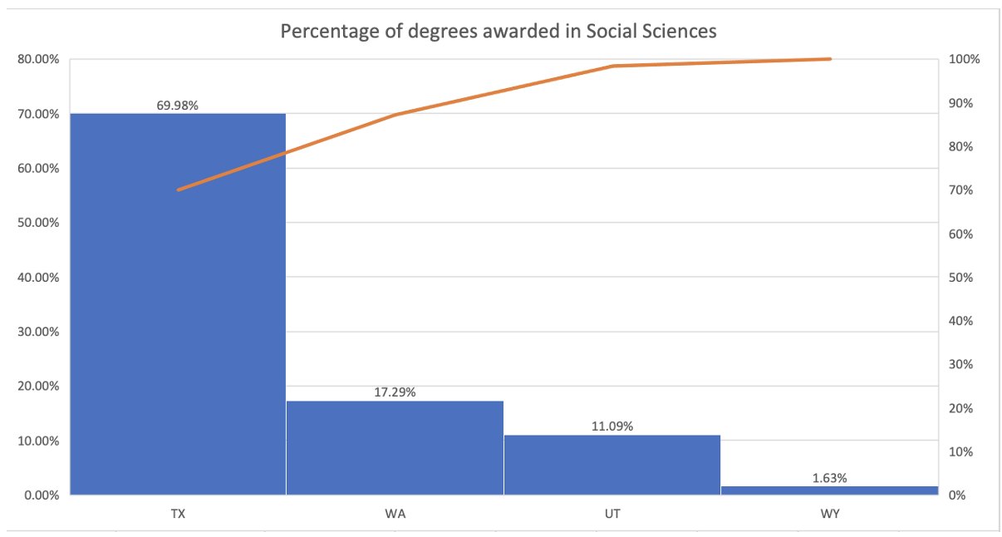
Data Modeling “Percentage of degrees awarded in the professions of Social Science fields”
Key findings:
Highest percentage of degrees awarded in Social Science was Texas (TX).
Lowest percentage of degrees awarded in Social Science was Wyoming (WY).
This variable is significant to analyze because it will help in the recruitment of Tesla employees who understand fully the company's mission to develop products that help society.
Economics and other social science majors may analyze how Tesla vehicles are produced, distributed, and used in the workplace.

Slide 19
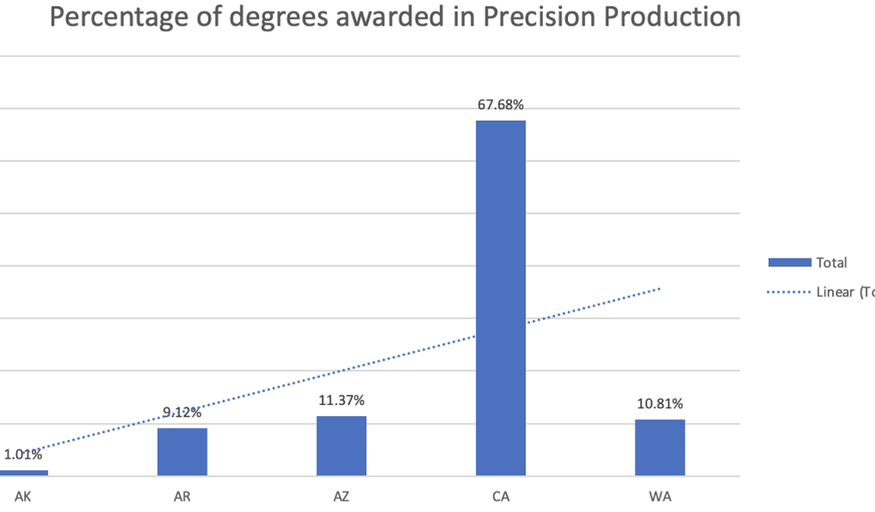
Data Modeling “Percentage of degrees awarded in the professions of Precision Production fields”
Key findings:
Highest count of degrees awarded in Precision Production was in California.
Lowest percentage of degrees awarded in Precision Production was in Arkansas.
This variable could be significant to further analyze because it will help Tesla look for candidates that could help assist them with the production strategies.
Having a degree in Precision Production can help students land a job in operating production machinery.

Slide 20
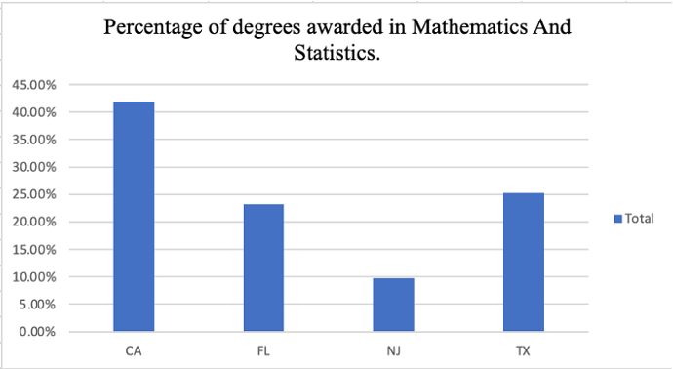
Data Modeling "Percentage of degrees awarded in Mathematics and Statistics"
Key Findings:
California had the highest percentage of degrees awarded in Mathematics and Statistics. Texas being the second highest. And New Jersey had the lowest percentage of degrees awarded in Mathematics and Statistics.
Overall, analyzing this aspect may be important in determining the overall percentage of degrees in mathematics and statistics, which will eventually assist the organization recruit individuals who will benefit from their financial operations.

Slide 21
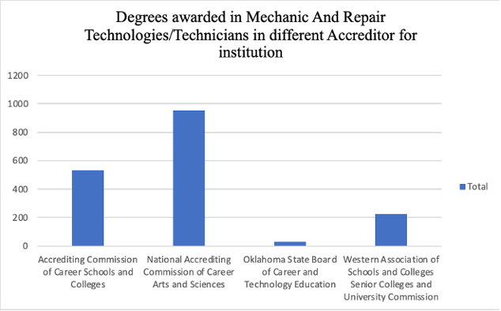
Data Modeling “Percentage of degrees awarded in Mechanic and Repair Technologies/Technicians”
Key Findings:
The National Accrediting Commission of Career Arts and Science had a higher total count of degrees awarded in Mechanic and Repair Technologies/Technicians than at different institutions.
Having a degree in Mechanics and Repair Technologies/Technicians would help them start a career with Tesla as they need people with skills in Mechanics and Repair Technology and Technician.

Slide 22
Progress Report(Milestone 6)
Multi-Linear Regression Model Enrolled Undergraduate Students (UGDS) and Computer and Information Sciences and Support Services Majors (PCIP11) Region 1, which includes, CT, MA, ME, NH, RI, VT.
Key Findings:
Coefficient - as the value of Enrolled Undergraduate Students (UGDS) increases by 1 the Computer and Information Sciences and Support Services Majors (PCIP11) increases by 1.55.
P-Value – values range from <0.0001-0.0256 meaning the values are statistically significant because all the values are lower than 0.05.
Multiple R - shows a weak relationship between Enrolled Undergraduate Students (UGDS) and Computer and Information Sciences and Support Services Majors (PCIP11) since the value is closer to 0 than in it is to 1.
R Squared – the goodness of fit for this model, since our model shows that 7% of the variables fall on the regression line. This model is still a good fit because our Coefficient and P-Value are statistically significant.

Slide 23
Conclusion
Our goal was to set out and utilize data to identify states where Tesla Inc. would benefit from local newly graduated individuals looking to enter the workforce.
By analyzing data from several states, regions, and educational institutions and drilling down to majors relevant to potential functions at Tesla, we were able to successfully meet the business goal.
We can now make a recommendation supported by data of which U.S. States Tesla can consider to open manufacturing operations where it can quickly fulfill its candidate pool.
We have identified that Tesla can quickly meet its need for candidates in eastern states, such as New York, or Pennsylvania and western states, such as California or Texas given its relatively high number of graduates from specialized fields related to Information Technology and Engineering.

Slide 24
References
Data home. (n.d.). Retrieved from https://collegescorecard.ed.gov/data/
Gupta, S. (2020, May 26). Tesla SWOT analysis (2022). Retrieved from https://bstrategyhub.com/tesla-swot-analysis/

Slide 25

Questions?

